Slide 1

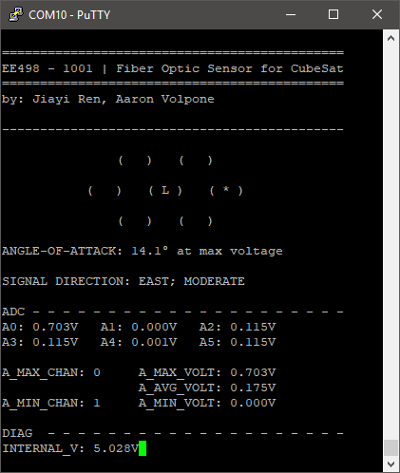
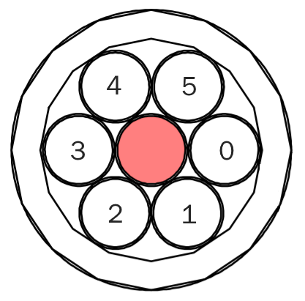
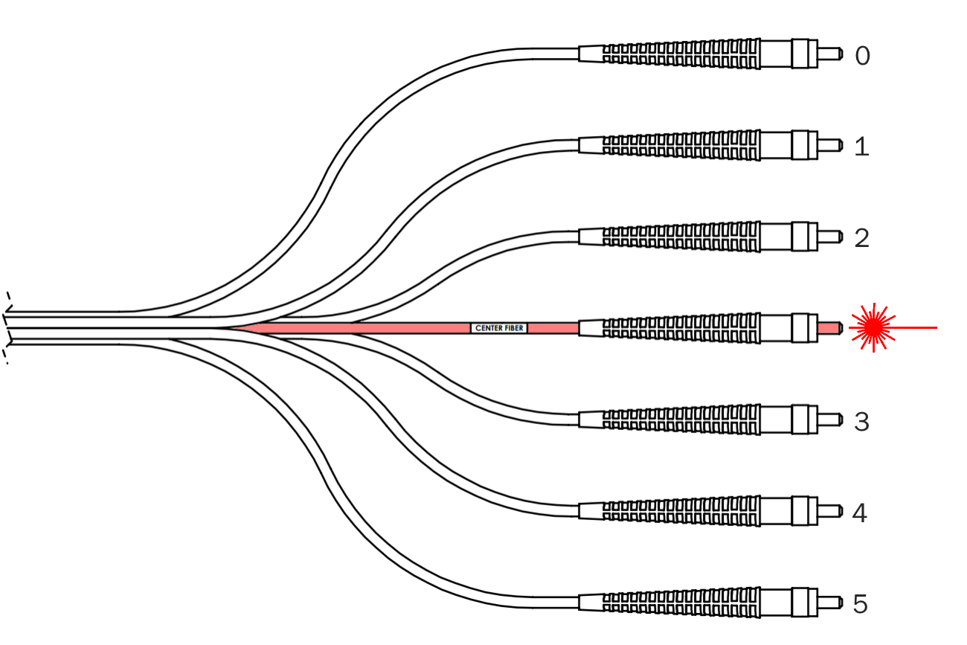
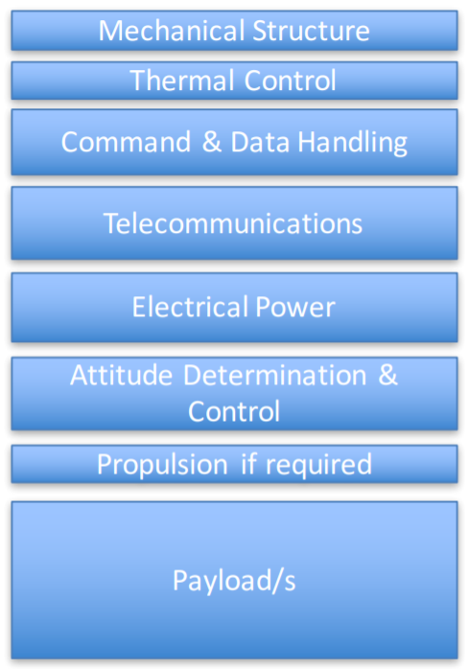
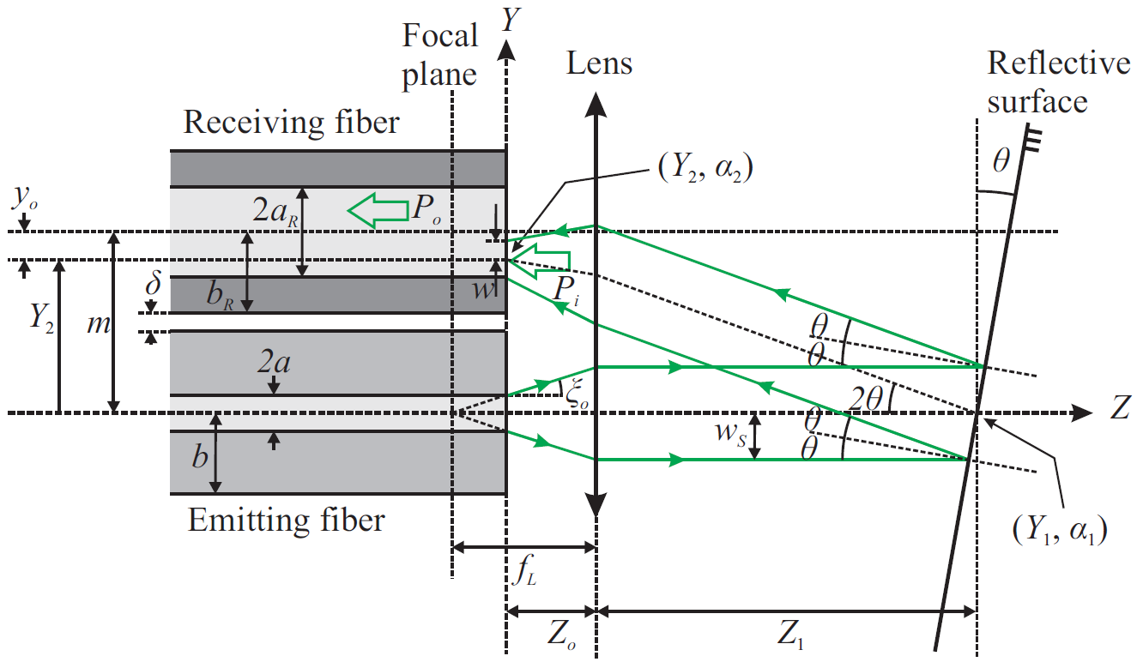
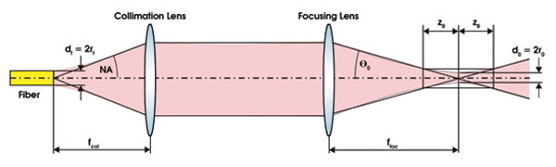
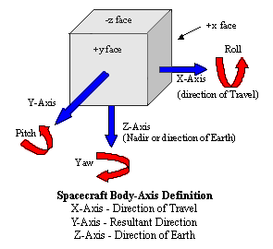
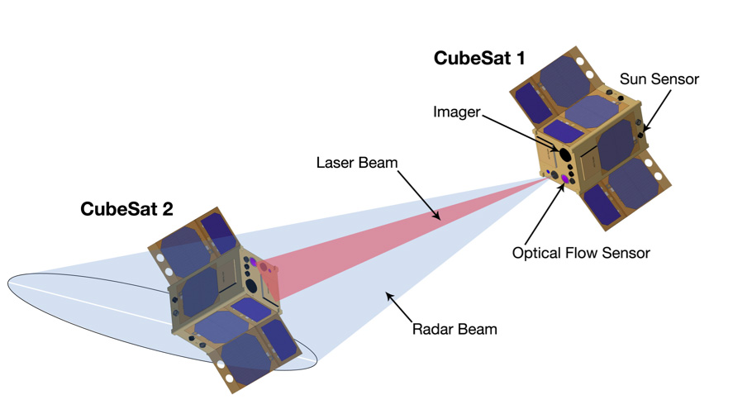
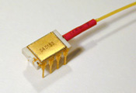
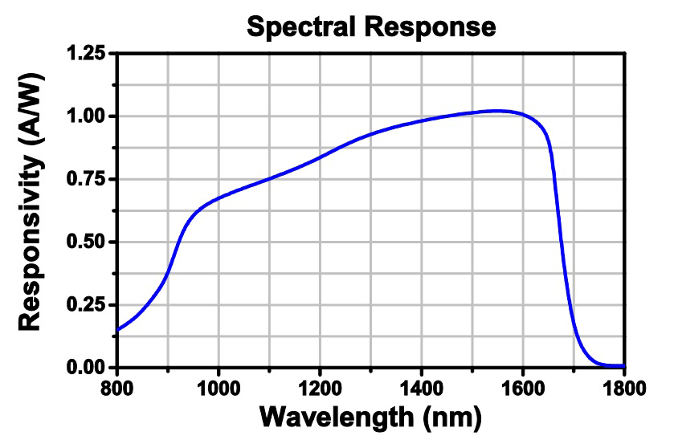
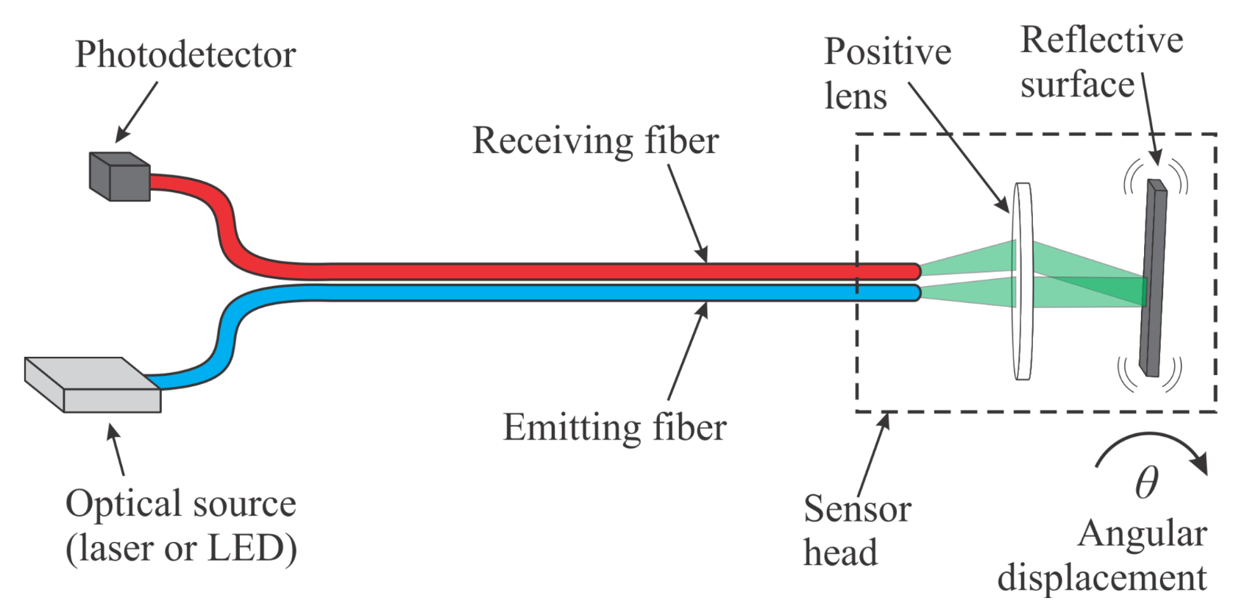
Fiber Optic Sensor for CubeSat
Instructor: Dr. Grzegorz Chmaj
Faculty Advisor: Dr. Ke-Xun Sun
Jiayi Ren, Aaron Volpone
University of Nevada, Las Vegas – Department of Electrical and Computer Engineering
Introduction
Fiber Optics
Software
The advent of CubeSats have enabled universities and space agencies alike to conduct research at much lower financial costs than conventional, bulky satellites CubeSats, on the other hand, boast notable features:
10cm³ volume, weighting 1.33kg per unit (U)
Modular and miniaturized, can be built in several unit sizes: 1U, 2U, 3U+
Affordable, with the average launch price being around $40,000
Schools (along with private organizations) have taken interest in designing CubeSats due to their affordability and accessibility. As a result, they have become good tools for education related to various fields of engineering and sciences.
Fiber optic cables carry light instead of electricity. Through this simple trait, they provide several advantages in the field of data transmission and sensing over conventional copper wire communications. Some primary features of fiber optics are as following:
Longer distance transmission – fiber optics benefit from minimal power loss, meaning they can be transmitted over great distances.
High bandwidth capability – the volume of data that fiber optics can transmit per unit of time is far greater than copper wire.
No moving parts – moving items create wear and can fail. In the realm of space, repairs are a nearly impossible (even unnecessary) task.
Resistance to electromagnetic interference – fiber optic cables are not prone to radio interference caused by electrical circuitry.
The implementation of fiber optics in this CubeSat project opens the possibility for multiple uses in several future projects.
Interfacing with the sensor board is done through UART communication. With a computer, an operator is able to see the data being readout from the sensors and also communicate with the sensor board for debugging. It is capable of several features:
Overview mode– displays all ADC sensor data along with a visualization of which photodiodes are receiving a laser signal.
Testbench mode– designed for communicating with a CubeSat test platform. If connected to another processor, it could send signals to adjust its angle-of-attack and zero in on a received laser signal.
ADC debug mode– allows the operator to see the ADC channels changing in real-time to check calibration and operating status of the board.
FIGURE 7
Project Goal
The sensor array is built into the same cable that the laser signal originates from. Angular displacement is found by bouncing the laser signal back into the array of photodiodes with a reflective surface.
Ultimately, the goal of this project was to design a displacement sensor board that would later used in a future UNLV CubeSat project. The development process for components in a CubeSat require collaboration between various engineering disciplines. For the duration of this two semester Senior Design project, a foundational concept was derived and started for measuring angular displacement between . Use of fiber optics in replacement of conventional sensors provide several advantages, these will be elaborated in other modules.
In terms of the hierarchical structure of a CubeSat, the fiber optic sensor falls under Attitude Determination & Control. The intent of previous and future projects is to consolidate work into a fully functioning CubeSat. All parts should be designed with the intent to interface with other modules made by various teams.
FIGURE 1
FIGURE 4
FIGURE 4
Hardware
The theta value created by the reflective surface will determine which photodiodes receive the laser signal. Each receiving fiber sits a fixed distance from the emitting fiber - where the laser emitter shoots. In order for the pinpoint laser to be seen by adjacent photodiodes, its output beam must be manipulated in open space.
FIGURE 5
Photodiodes converts light into an electrical signal, current or voltage. The electrical signal can be only measured in the milli units. Therefore it is necessary to have photodiode electrical signal amplified in order to obtain precise reading for the use of application. With voltage amplifier, the amplified signal in the range of several volts then is processed by a microcontrollers for Analog to Digital Conversion (ADC). A digital signal can finally be programmed for angular displacement sensing.
FIGURE 1
FIGURE 5
Future Improvements
Measurement
Angular Displacement
FIGURE 8
A laser passes through a lens to collimate into open space, and then another to refocus into a photodiode array. The open space is the implied distance between two CubeSats in space.
For future development, it is possible to scale down the overall design into more compact size. Additionally, the design might be further improved by reducing the number of photodiodes. Another possible improvement is to complement with different optical system instead of reflection technique for pitch, yaw, and roll three dimensional angular displacement detection.
Measurement of angular displacement is to determine at what degree an object is facing toward a relative point-of-reference. In this case, the point of reference is a neighboring CubeSat in space. Adjustments in alignment are to be done until CubeSats face each other.
FIGURE 6
The reflected laser signal’s will depend on its angle of attack on the surface is being shot at. Six fiber cores that surround the laser signal will be receiving these laser varying laser intensities depending on how it’s being reflected back. at a significant angle, it should be easy to that the laser is. sensor array is built into the same cable that the laser signal originates from. Angular displacement is found by bouncing the laser signal back into the array of photodiodes.
Angular adjustment between two paired CubeSats is done by firing an infrared laser at its neighbored satellite. At an angle, the laser signal will appear stronger on sensors that are angled more toward the center of the originating laser beam. The difference between laser intensities is how displacement is computed.
FIGURE 6
FIGURE 2
FIGURE 8
Conclusions
FIGURE 2
Fiber Optic Sensor for CubeSat utilizes fiber optics and simple electronics to produce angular displacement measurement with high precision and reliability. This project can be developed and integrated for any related projects. With the advantages of fiber optics, residential and commercial use of such design is also possible for future technology development.
By firing a laser into space and then refocusing its beam on the receiving end of a CubeSat, we can use the angle that it approaches to find where a neighboring satellite is facing. We accomplish this by reflecting the laser signal back into an array of photodiodes to compute their values.
FIGURE 3
Fiber Coupled InGaAs PIN photodiode
Acknowledgements
Determining displacement with the use of fiber optic equipment etc etc
FIGURE 3

